Slide 1

MEDICAL COST PERSONAL

Slide 2

OUTLINE
1. Executive Summary
2. Introduction
3. Methodology
4. Result
4.1. Charts
4.2. Dashboard
5. Discussion
6. Conclusion

Slide 3

1.EXECUTIVE SUMMARY
Overview about Medical Cost Personal.
Number of people check medical and charges
BMI rate by age categories and charges.

Slide 4

2.INTRODUCTION
Specify numer of people average charges, average bmi by sex, bmi categories and age categories.
How Age affects Health Insurance Cost?
Obese rate in adult people.

Slide 5

3.METHODOLOGY
Data Collection
+ Collecting Data from Kaggle
Data Wrangling
+ Duplicate column
+ Return values with specified conditions using Case statement (SQL)
- Exploratory Data Analysis
+ Analyze, explore data (using View)

Slide 6
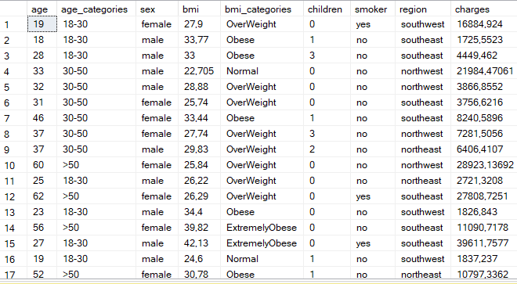
4. RESULT

Slide 7
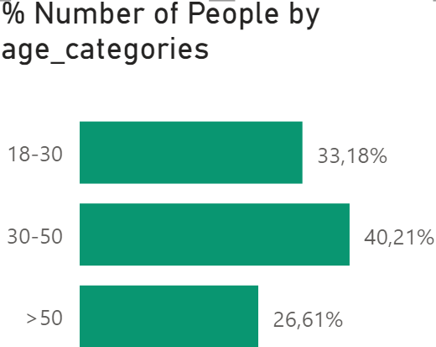
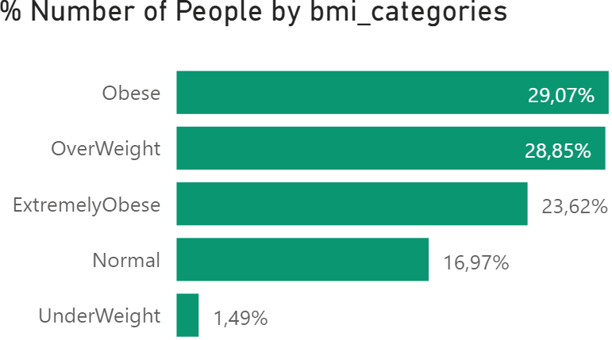
4.1.CHARTS
There are 1338 people (49.48% men and 50.52% women).
40.21% among those ages 30-50 include those who were financially stable, so they pay more attention to their health.
Most of people belong to the over weight group (over weight, obese and extremely obese) with 81.54% and only 1.49% belong to the under weight group.

Slide 8
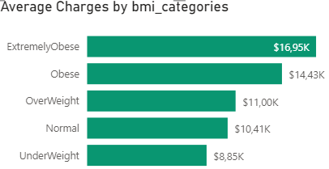
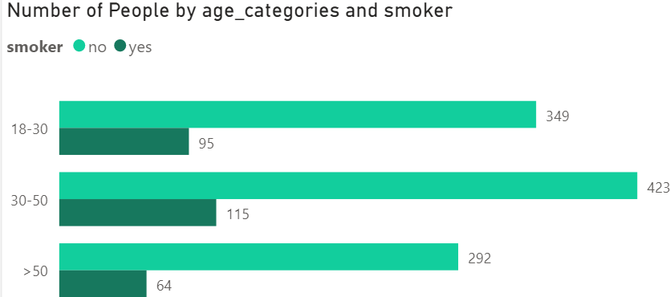
4.1.CHARTS
Average BMI of men higher than women. Men also tend to have higher smoking rate than woman (58% & 42%).
Average charges increase with BMI category levels (from under weight to extremely obese).
For people aged 18-50, they have higher pevalence of smoking than people over 50 (77% & 23%)

Slide 9
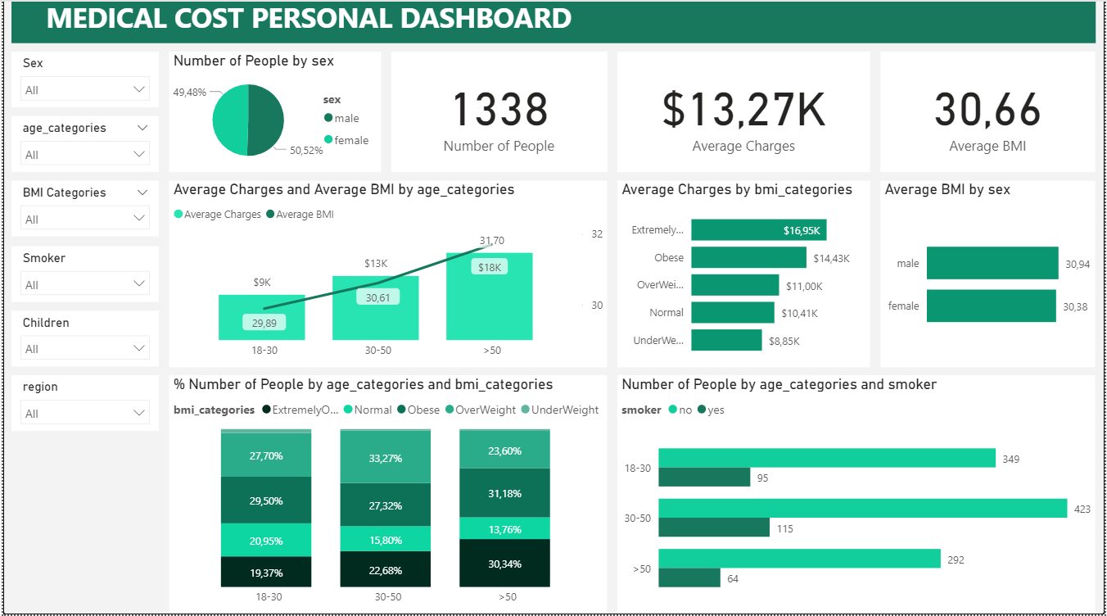
4.2. DASHBOARD

Slide 10

5. DISCUSSION
How Age affects Health Insurance Cost?
Obese rate in adult people.

Slide 11
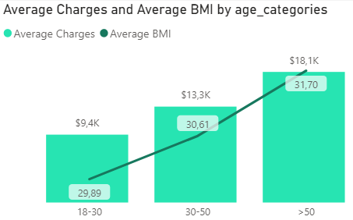
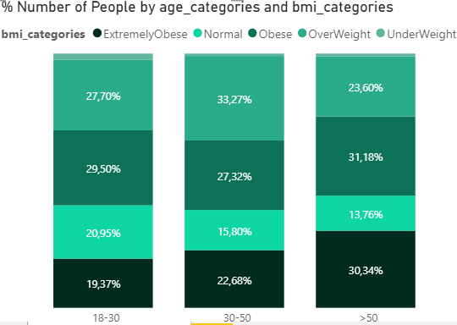
5. DISCUSSION
Average charges and average BMI increase with age categories. For people over 50, average charge was $18.1K, compared to those aged 18-30 it doubles, just $9,4k. It means the older you are, the higher your medical quotes.
The obesity prevalence (extremely obese, obese, over weight) was 76.12% among adults aged 18-30, 83.27% among adults aged 30-50 and 85,12% among adults aged 50 and older.
Nowadays, people are so busy and they use fast food so much and lazy to workout. This is one of the reasons make them easily get diseases like obesity or heart disease.

Slide 12

6. CONCLUSION
The biggest factor that influences your health insurance quote will be your age.
The highest obesity prevalence was 85,12% among adults aged 50 and older.

